Slide 1
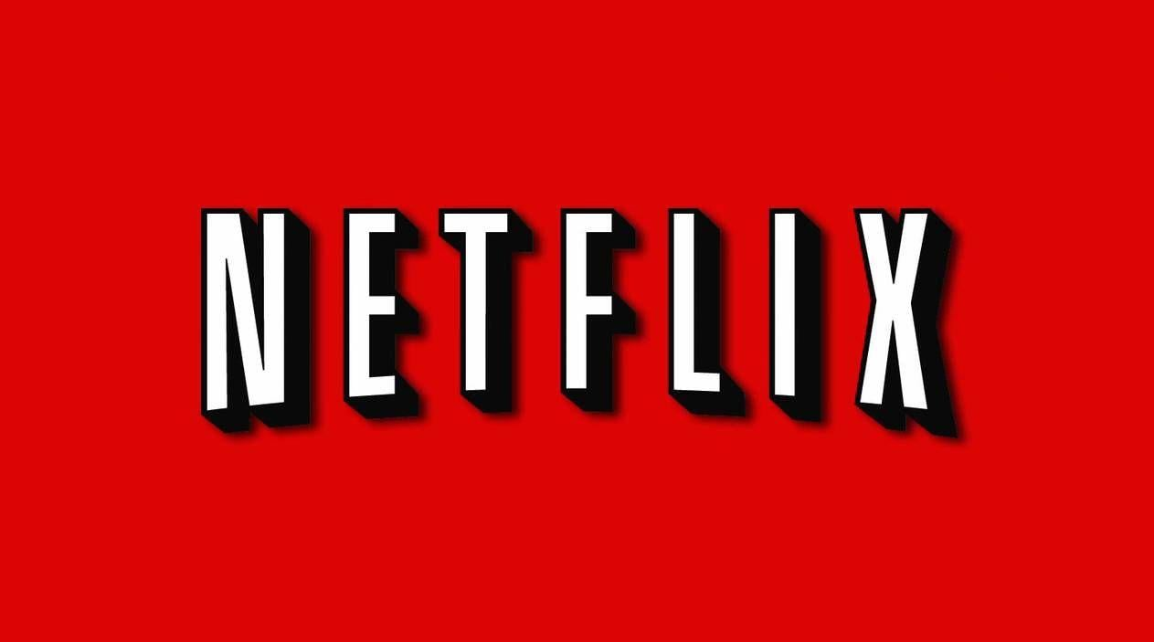
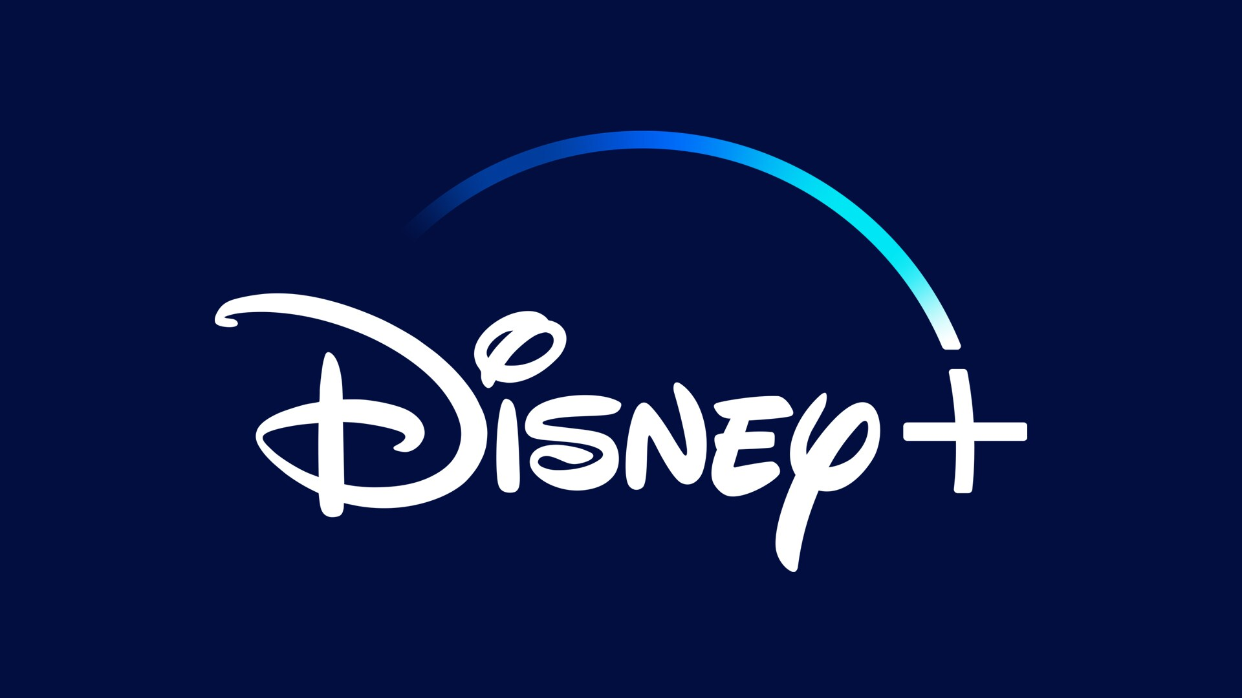
STREAM WARS: WINNING INSTAGRAM ENGAGEMENT A Netflix vs. Disney+ Showdown
Vaishnavi Ganesh
Santhosh Kumar
Sanjhana Rangaraj
Sai Lakshmi
Rajkumar Rajavel

Slide 2
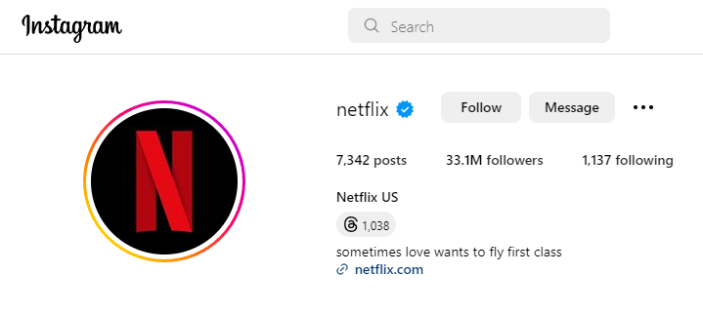
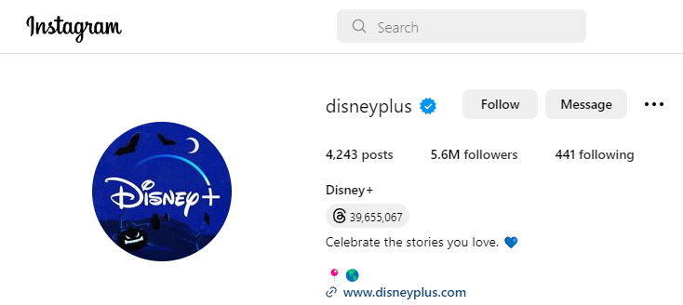
PROBLEM STATEMENT
Disney+ and Netflix are two major players in the streaming industry (with 150 and 220 million paid subscribers*)
Despite Disney+ having a rich history of content and owning popular franchises like Marvel and Star Wars, it lags Netflix in terms of Instagram engagement
Among recent posts, average likes per post is ~190k for Netflix vs. ~77k for Disney+ and average number of comments are ~700 vs. ~300
*Data up to Q2’22, reference - https://www.visualcapitalist.com/cp/netflix-versus-disney-subscribers/

Slide 3
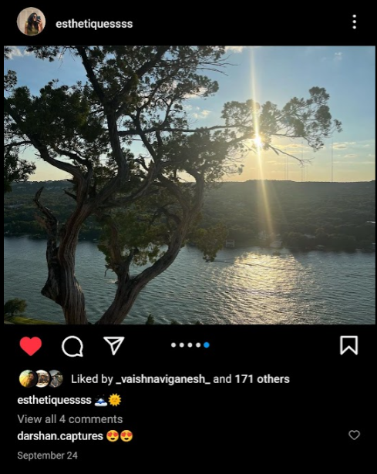
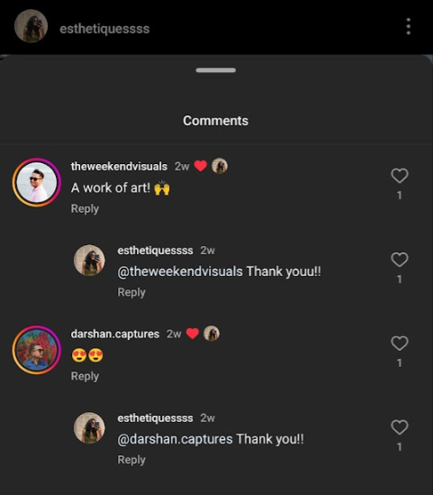
DATA SOURCES & PRE-PROCESSING
Instagram pages of Netflix and Disney+ were scraped to obtain following features from image-only posts,
Post URL
No. of likes
Post caption
No. of comments
Count of comments include ‘parent’ comments + replies to comments
Comment text
Taken only for top 50 ‘parent’ comments (comments with highest no. of likes)
Image URL
Only the first image of ‘carousel’ posts were chosen
Posts with extremely large number of likes (above mean + 2 standard deviations) were removed as part of pre-processing*
Removal of links, emojis, punctuation, stop words, word tokenization, lemmatization
*Outlier posts for Disney+ all focused on ‘Loki Season 2,’ a season most fans have been awaiting waiting 2.5 years for, and for Netflix focused on ‘Barbie’, ‘Wednesday’ and Jennifer Aniston (with Adam Sandler :)

Slide 4
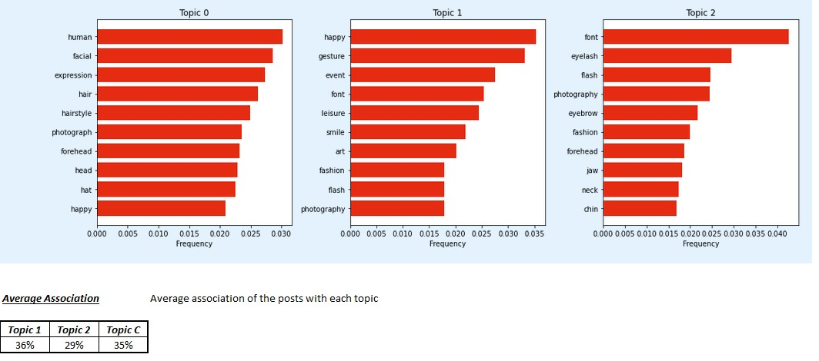
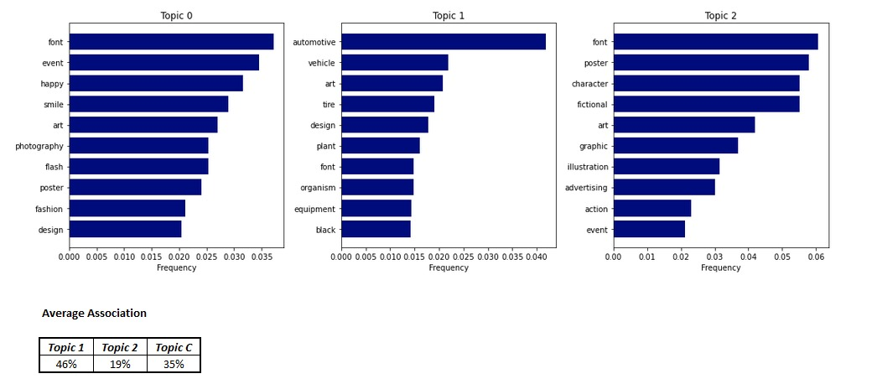
TOPIC MODELLING (1/2)
Used Google’s Cloud Vision
It tagged labels to each image (labels include identifying general objects, locations, activities, animal species, products, and more)
Topic modelling performed with these labels (3 topics chosen, along with words and their weights associated with each topic)
– topic 1 and 2 are focused on humans, topic 3 looks more like a poster for Netflix, whereas for Disney+, topic 1 human-centric, topic 2 music and arts but not distinguishable, topic 3 large-font posters, lot of animation posters
*Average association correct labels read: topic 0, topic 1, topic 2

Slide 5
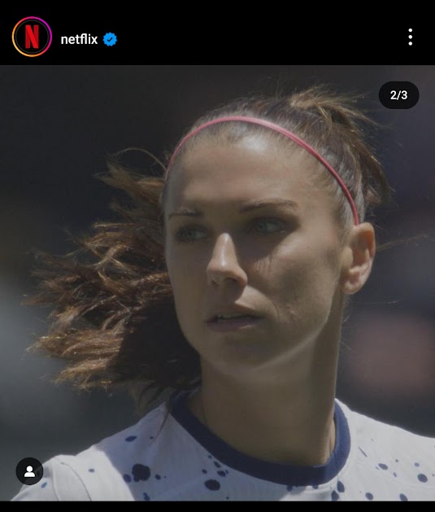
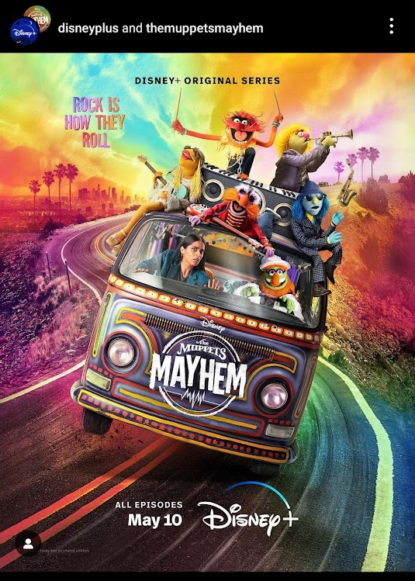
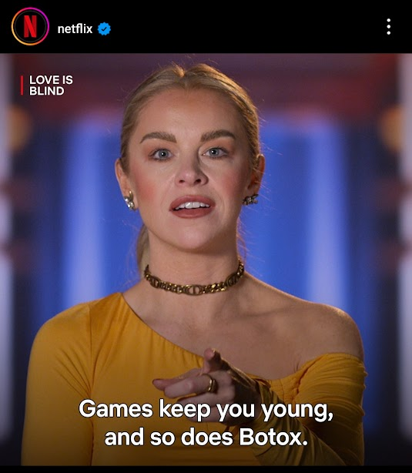
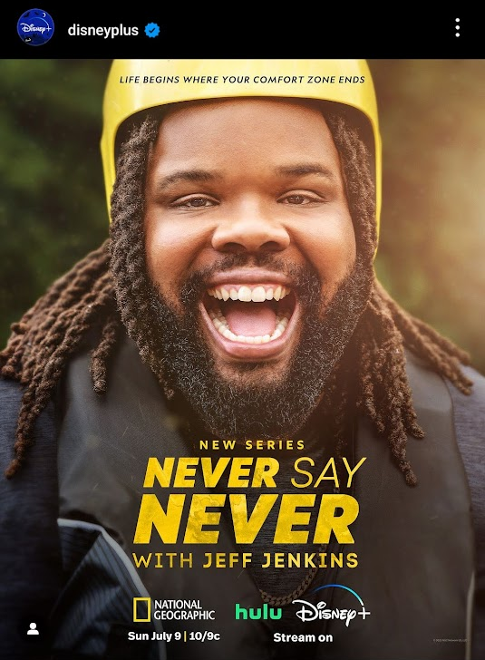
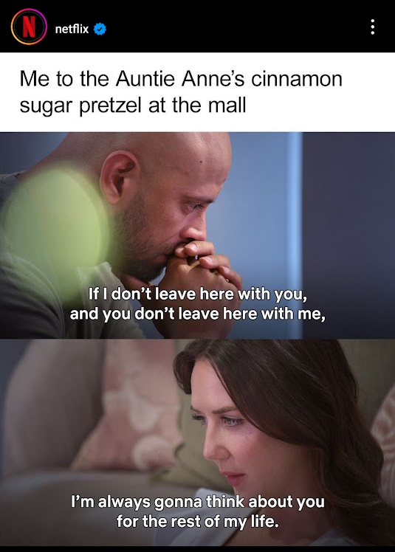
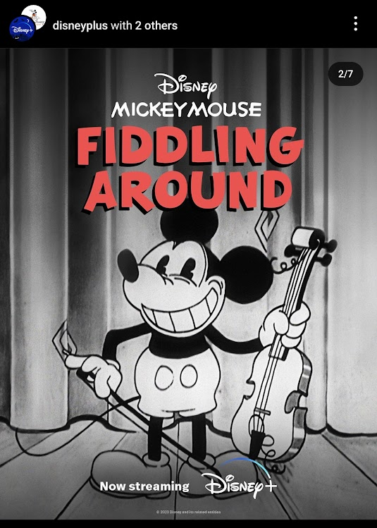
TOPIC MODELLING (2/2)
For Netflix, topics could be labelled: ‘Character close ups’, ‘Character quote/poster’, and ‘Close-to-meme’
Topics did not differ from each other well enough
For Disney+, topics could be labelled: ‘Character posters’, ‘Object posters’, and ‘Animated content’
There is better differentiation but nothing that could possibly explain lower engagement as topics were mostly like that of Netflix
NETFLIX
DISNEY+
Topic 0
Topic 1
Topic 1
Topic 0
Topic 2
Topic 2

Slide 6


Original classification
IMAGE CLASSIFICATION
Google Cloud Vision
Memes
Others
Cleaner classification
Azure Computer Vision
Posters
Not Posters
Google Cloud Vision
Memes
Others

Slide 7
MEME-ORABLE EDGE
NETFLIX
DISNEY+
POST CATEGORY | COUNT OF POSTS | AVG. ENGAGEMENT SCORE | COUNT OF POSTS | AVG. ENGAGEMENT SCORE
Posters | 26 [10%] | 90 | 105 [43%] | 60
Memes | 65 [25%] | 80 | 19 [8%] | 55
Not memes, not posters | 166 [65%] | 90 | 122 [50%] | 80
Engagement score is a composite metric of number of likes and sentiment score derived from comments (both of which are normalized to fall with a range of 0 to 1); this was then scaled up by a 1000 for readability

Slide 8
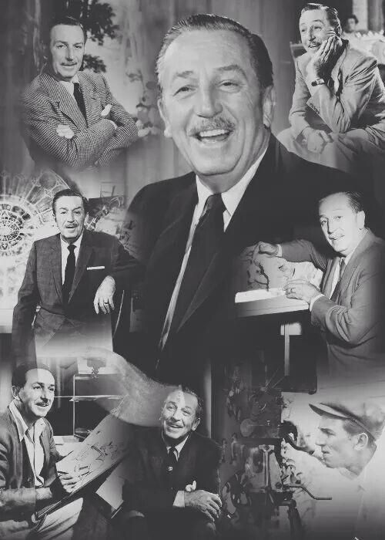
LAUGHTER LEADS: DISNEY NEEDS TO (RE)LEARN TO SMILE…
Human-centric stood out too, but memes felt more interesting and differentiating between the two services
Memes can be personal, and hence more relatable
More likely to be reshared than just a run-of-the-mill announcement poster
Overall Disney+ can learn from the positive and humorous approach Netflix has taken
Potential analyses,
‘Meta’ references from Netflix are unique too
Reels, reels, and more reels
Memes lead to “hahahahahahahahahaha(AAHA)hahaha…”

